Slide 1






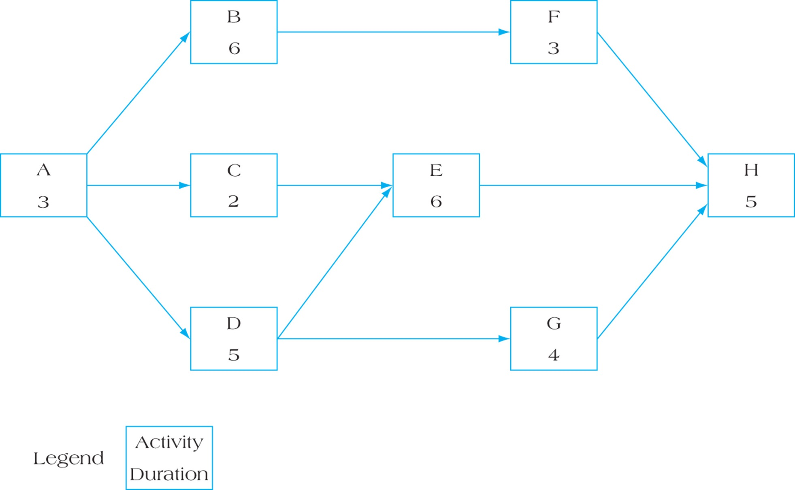

MGMT 6058 Module 5
Exercises
Do the exercise prior to next slide
Videos
Solution Slide
PPT Animations
Project Scheduling: Lags, Crashing, AOA
Exercise Simulation
Printout
M5 HANDOUT EXERCISE Table of Crash Cost A to H.docx
Printout
M5 Excel AON A to H for PPT for STUDENTS V1.xlsx
Use Excel
See text in “slide note” for more details
Printout
Use Excel
M5 Digital EXERCISE Cumulative Crashing w overhead & penalties.xlsx

Slide 2
Module 5 Learning Objectives
After completing this module, students will be able to:
Apply lag relationships to project activities.
Recognize alternative means to accelerate projects, including their benefits and drawbacks.
Understand the trade-offs required in the decision to crash project activities.
Develop activity networks using Activity-on-Arrow techniques.
Understand the differences in AON and AOA and recognize the advantages and disadvantages of each technique.
Controversies in the Use of Networks
Review and practice the 3 exercises in this PowerPoint, only look at the green solution slides after you have attempted your own solution first

Slide 3
Expanding from last module …
Round Up vs Round Off?
Project Duration Estimates
When we have a range of estimates for an Activity, such as Optimistic, Most Likely and Pessimistic , we frequently use the PERT duration formula
Note however, we typically use durations rounded to the nearest day, rather than decimals of days from our PERT formula. Usually we “round up” rather than “round off”.
Even short durations such as 3 hours, we round up to a day. One of the reasons for this, is to avoid scheduling a 3 hour activity A with a 4 hour successor activity B on the same day. We might not know exactly what time of day activity A might start. It could start in the afternoon forcing activity B to start on the following day.
Notes:
Round off means moving to the closest level of precision. If we round off a duration to the nearest integer, 3.2 becomes 3 days and 3.7 days becomes 4 days. But with round up, both 3.2 and 3.7 become 4 days.
Typically if we are scheduling resources to a granularity of a day, we round up to the next highest day.

Slide 4
From the previous slide …
Duration ≠ work
When we rounded up activity A from 3 hours to 1 day, it does not mean activity A takes 8 hours of work to get it done, it means the 3 hours of work might take an elapsed 8 hours in a day before it is finished.
Duration ≠ work, duration hrs do NOT equal work hrs
The 3 hours of work might occur in the morning from 8am to 11am, or in the afternoon, or it might take 2 hours in the morning and 1 hour in the afternoon.
If we had 10 hours of work (the duration could be 10 hours as well with overtime), but based on an 8-hour day we rounded up to 2 days, we might schedule the work for 5 hours on day 1 and 5 hours on day 2. We don’t really know when exactly the work will be done over the 2 days but we might schedule it 5 and 5 for simplicity.

Slide 5
Lags in Precedence Relationships
The logical relationship between the start and finish of one activity and the start and finish of another activity.
Four logical relationships between Activities
Finish to Start
Finish to Finish
Start to Start
Start to Finish
Rare

Slide 6
Finish to Start Lag
This is the most common relationship
How do we “read” the precedence arrow?
Most common type of sequencing
Shown on the line joining the modes
Added during forward pass
Subtracted during backward pass
This lag is not the same as activity slack
0 A 6
Spec Design
6
6 B 11
Design Check
5 15
15 C 22
Blueprinting
19 7 26
Lag 4
Use of the lag must be maintained in both forward and backward pass
This could be 26 rather than 22 as more activities follow
Lag - waiting for building permit, concrete to cure, sealant to dry, waiting for material to come in.
Notes:
We use logic for the precedence relationship between tasks by starting at the arrow head, and note whether the arrow head is as the start or finish end of the Activity. For example, the arrow with the lag in this slide – start at the arrow head. The start of C (the arrow head is at the start end of C), depends on the finish of B (the tail of the arrow is at the finish of B). But we name or write the relationship, as if we’re going the other way, we name the tail first and then the arrow head, Finish to Start or FS (+4d lag) for this particular arrow.

Slide 7
Finish to Finish Lag
Two activities share a similar completion point
The mechanical inspection cannot happen until wiring, plumbing, and HVAC installation are complete
The lag could be a wait for a supervisor to travel and approve the Wiring
30 D 36
Wiring
6
Read this dependency arrow starting at the arrowhead – the “finish of B” depends on the “finish of A” plus 3
Lag 3
34 A 36
Plumbing
2
36 B 39
HVAC
3
39 C 45
Inspection
6
31
33
33
39
Where is the FF arrow?
The EF for B is NOT 33 + 3 d = 36
If the duration of Plumbing was 1 day, what would the EF for HVAC be?
Notes:
We use logic for the precedence relationship starting at the arrow head, and whether or not the it as the start or finish end of the Activity. For example, the arrow with the lag in this slide – start at the arrow head. The finish of B, depends on the finish of D.
If Activity A (Plumbing) was a 1 day duration instead of 2, it would change the ES for B, but would NOT change the EF for B.

Slide 8
Start to Start Lag
Where would you use start-to-start relationships in a deck project?
30 D 36
Wiring
6
What if the Lag was 5?
Lag 5
35 B 38
HVAC
3
38 C 39
Inspection
1
31 A 33
Plumbing
2
Notes:
If the lag was 5 days, the ES for HVAC is 30 +5 = 35 as we have a merge and we take the later time.

Slide 9
Start to Finish Lag (not Finish to Start)
Rarely used and misleading because of implied time line
B
D
FS vs SF
Which is which?
Rarely used type of relationship
Successor’s finish dependent on predecessor’s start
B
D
Read this dependency arrow starting at the arrowhead – the “finish of B” depends on the “start of A” plus 3
35 D 36
Wiring
6
What would be a better example of this rare relationship?
Lag 3
22 A 28
Plumbing
6
28 B 38
HVAC
5
38 C 39
Inspection
1
Notes:
In the top diagram in the upper right corner, look at where the arrowhead is on D, and “read” the arrow as “the Start end of D is dependent upon the Finish end of B, but we “name” the relationship the other way around starting at the arrow tail, the Finish (F) of B occurs, and then we can Start (S) D. A Finish to Start FS relationship.
An example of the reverse, a Start to Finish SF would be if activity B was a security team activity with a duration of 5, but they can’t finish until the next security team shows up which is activity D. If you remove the lag (we always want a security team present) and put these on a Gantt chart (timeline) it would make more sense. The lower of the 2 diagrams at the top right corner is a pseudo Gantt chart. We have moved D to the right of B, and it reads as follows. We can’t finish B (look at the arrowhead first) until Activity D starts. In other words Security team B can’t go home until Security team D shows up. But of course we name it starting at the tail, the Start (S) of D occurs, and then we can Finish (F) B. A Start to Finish SF relationship.

Slide 10
Schedule Compression – Fast-tracking vs Crashing
The process of accelerating a project, reducing the project duration, for reasons such as :
The initial schedule was too aggressive and the project is falling behind schedule (so the remaining schedule has to be accelerated)
The project has to finish earlier than planned.
The project has slipped behind schedule.
Avoid a late penalty, or earn a finish early bonus
We apply compression to the critical path and in general compression:
Improves existing resources’ productivity
Can involve changing work methods
Can compromise quality and/or reduce project scope
Why apply to the critical path?
Notes:
We apply compression techniques only to the critical path activities. If we applied them to non-critical path activities, we would be taking a path that has slack, and create more slack, but this won’t reduce the project duration which is the critical path.
Lags separate or delay one activity following another, leads (the opposite of lags, sometimes referred to as negative lags), make the activities overlap.

Slide 11
Schedule Compression – Fast-tracking vs Crashing
Comparison - Fast-tracking vs Compression
Use fast-tracking which doesn’t require more cost
Overlap activities
Or use start to start lag relationships (which is also an overlap)
Sometimes higher risk
Use crashing, which involves a cost increase to shorten the duration of an activity
Work overtime
Increasing the quantity of resources
Use higher cost resources that are more productive
B
D
B
D
B
D
B
D

Slide 12
Managerial Considerations
Shorten activities on the critical path to reduce project duration
Determine activity fixed and variable costs
The crash point is the fully expedited (can’t be shortened any more) activity
Optimize time-cost tradeoffs
Cease crashing when
the target completion time is reached, or
the crashing cost exceeds the penalty cost

Slide 13
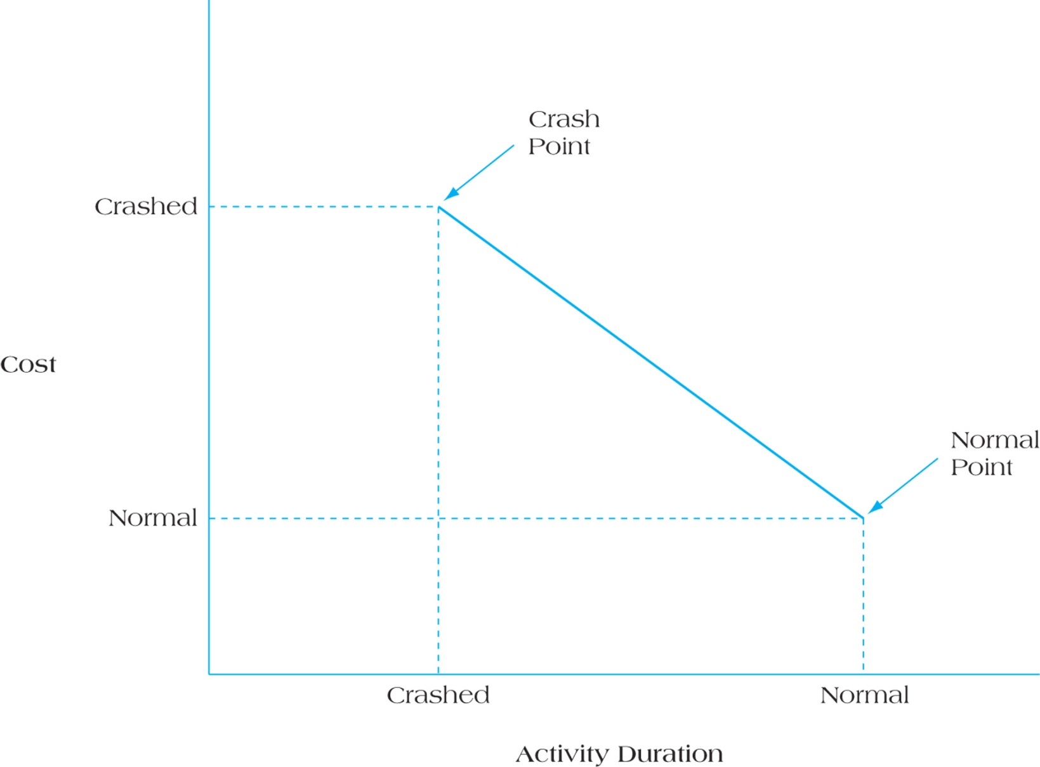
Crashing, Time vs Cost
Cost Trade Off = Slope = crash cost – normal cost
normal time – crash time
The crash point is a shorter duration, is it normal for this to cost more?
Figure 10.14 Time–Cost Trade-Offs for Crashing Activities
Notes:
Typically if you want something done faster, it’s more expensive.

Slide 14
Suppose that for activity X, the normal activity duration is 5 weeks and the budgeted costs is $12,000. The crash time for this activity is 3 weeks and the expected cost is $32,000.
Calculate the cost of to crash these activities per week.
$32,000
$12,000
3 weeks
5 weeks

Slide 15

Suppose that for activity X, the normal activity duration is 5 weeks and the budgeted costs is $12,000. The crash time for this activity is 3 weeks and the expected cost is $32,000. Calculate the cost of crashing activities per week.
$\frac{Rise }{Run} \frac{32,000 −12,000}{5−3}$ = $10,000 per week
$32,000
$12,000
3 weeks
5 weeks

Slide 16
Project Activities and Costs Crashing Costs for each Activity
Table 10.1

Slide 17
First Calculate the Crashing Costs (per day) for each activity, first 3 columns ONLY
Activity | Calculation | Crashing Cost per day | Max Days
A | (1500-1000)/2 | 250 | 2
B
C
D
E
F
G
H
or
M5 HANDOUT EXERCISE Table of Crash Cost A to H.docx
Printout
or
Use this Slide

Slide 18
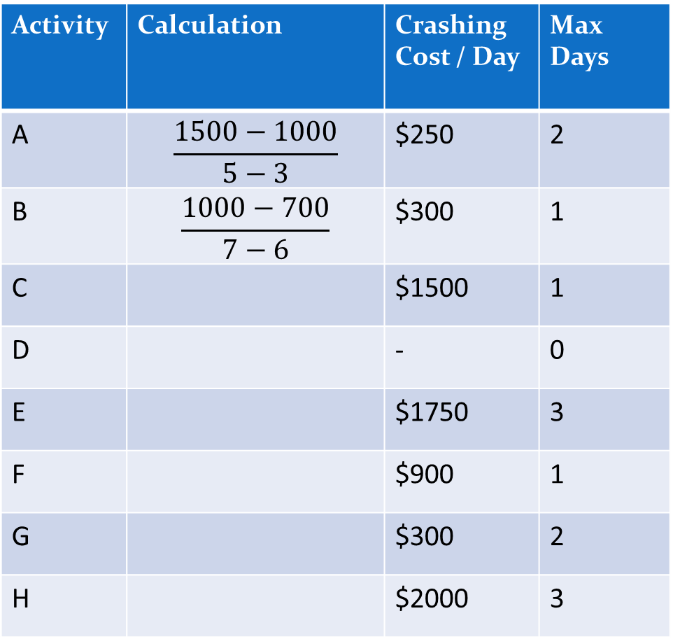
Calculate the Crashing Costs (per day) for each activity
Activity | Calculation | Crashing Cost / Day | Max Days
A | $$\frac{1500−1000}{5−3}$$ | $250 | 2
B | $$\frac{1000−700}{7−6}$$ | $300 | 1
C |  | $1500 | 1
D |  | - | 0
E |  | $1750 | 3
F |  | $900 | 1
G |  | $300 | 2
H |  | $2000 | 3
#1, calculate the crashing cost per day on the sheet
#2, write (use one of the files on the next slide) numbers on the network diagram for a forwards and backwards pass

Slide 19
We’ve used our predecessors to create a network diagram, let’s figure out what activities are on the critical path and worth initial crashing
7
4
5
3
9
8
6
Use Excel
Printout
M5 Excel AON A to H for PPT for STUDENTS V1.xlsx
Do a forward and backward pass by:
Open the M5 EXCEL HANDOUT file and enter numbers in Excel (or print out the file)
Or draw the diagram on a blank sheet of paper

Slide 20
2nd figure out what activities are on the critical path and are worth crashing.
5
12
12
16
7
15
19
8
15
4
0
5
5
8
10
19
19
27
0
5
5
7
3
10
10
19
27
9
19
8
5
10
10
16
5
10
13
6
19
What are all the path durations and their slack?

Slide 21
2nd figure out what activities are on the critical path and are worth crashing.
Why is it important to see all paths?
5
12
3
12
16
3
7
15
15
19
8
4
24 days
25 days
0
5
5
8
10
19
19
27
0
2
0
0
0
5
5
7
3
10
10
19
27
9
19
8
27 days
24 days
Activity | Crashing Cost / Day | Max Days
A | $250 | 2
B | $300 | 1
C | $1500 | 1
D | - | 0
E | $1750 | 3
F | $900 | 1
G | $300 | 2
H | $2000 | 3
5
10
10
16
0
5
10
3
13
6
19

Slide 22
Crash Project - 1 day at a time, only on critical path
 | # of critical paths to crash | Name of Activities Crashed to reduce 1 day of Project Duration | Cost to crash Activities for the reduction of another day | Cumulative Cost | Project Duration
Project before Crashing | NA | NA | NA | 22450 | 27
Less 1 day | 1 | A | $250 | 22700 | 26
Less 2 days | 1 |  |  |  | 25
Less 3 days |  |  |  |  | 24
Less 4 days |  |  |  |  | 23
Less 5 days
Less 6 days
Less 7 days
Less 8 days
Less 9 days
We can find the cost for row 1 from our table of Normal Costs (a few slides previous)
Back to our - M5 HANDOUT EXERCISE Table of Crash Cost A to H.docx
or
Use this Slide

Slide 23
Crash Project - 1 day at a time, only on critical path
 | # of critical paths to crash | Name of Activities Crashed to reduce 1 day of Project Duration | Cost to crash Activities for the reduction of another day | Cumulative Cost $ | Project Duration
Project before Crashing | NA | NA | NA | 22,450 | 27
Less 1 day | 1 | A | $250 | 22,700 | 26
Less 2 days | 1 | A | $250 | 22,950 | 25
Less 3 days | 1 | E | $1,750 | 24,700 | 24
Less 4 days | 1 | E | $1,750 | 26,450 | 23
Less 5 days | 1 | E | $1,750 | 28,200 | 22
Less 6 days | 3 | H | $2,000 | 30,200 | 21
Less 7 days | 3 | H | $2,000 | 32,200 | 20
Less 8 days | 3 | H | $2,000 | 34,200 | 19
Less 9 days
Scroll this graphic down for two days, one day at a time

Slide 24
What are our network path durations after crashing A and then another A
Why is it important to see all paths?
Crashing “A” shortens all paths
10
14
3
10
3
3
7
13
17
8
15
4
22 days
23 days
0
3
3
6
8
17
17
25
0
2
0
0
0
3
5
3
8
8
17
25
9
17
8
25 days
Was
5
22 days
Activity | Crashing Cost / Day | Max Days
A | $250 | 2
B | $300 | 1
C | $1500 | 1
D | - | 0
E | $1750 | 3
F | $900 | 1
G | $300 | 2
H | $2000 | 3
3
8
8
14
0
3
8
3
11
6
17
What would be the durations if we crashed E and a 2nd E?

Slide 25
Crash Project - 1 day at a time, only on critical path
 | # of critical paths to crash | Name of Activities Crashed to reduce 1 day of Project Duration | Cost to crash Activities for the reduction of another day | Cumulative Cost $ | Project Duration
Project before Crashing | NA | NA | NA | 22,450 | 27
Less 1 day | 1 | A | $250 | 22,700 | 26
Less 2 days | 1 | A | $250 | 22,950 | 25
Less 3 days | 1 | E | $1,750 | 24,700 | 24
Less 4 days | 1 | E | $1,750 | 26,450 | 23
Less 5 days | 1 | E | $1,750 | 28,200 | 22
Less 6 days | 3 | H | $2,000 | 30,200 | 21
Less 7 days | 3 | H | $2,000 | 32,200 | 20
Less 8 days | 3 | H | $2,000 | 34,200 | 19
Less 9 days
Scroll this graphic down for two days, one day at a time

Slide 26
Our network after crashing A and then another A, then E and another E
Was
3
Was
3
3
10
1
10
14
1
4
7
11
11
4
15
22 days
21 days
0
3
3
6
8
15
15
23
0
2
0
0
0
3
5
3
8
8
7
15
15
8
23
23 days
Was
5
Was
9
22 days
Activity | Crashing Cost / Day | Max Days
A | $250 | 2
B | $300 | 1
C | $1500 | 1
D | - | 0
E | $1750 | 3
F | $900 | 1
G | $300 | 2
H | $2000 | 3
3
8
8
14
0
Was 3
1
3
8
6
9
15
What would be the durations if we crashed a 3rd E?

Slide 27
Crash Project - 1 day at a time, only on critical path
 | # of critical paths to crash | Name of Activities Crashed to reduce 1 day of Project Duration | Cost to crash Activities for the reduction of another day | Cumulative Cost $ | Project Duration
Project before Crashing | NA | NA | NA | 22,450 | 27
Less 1 day | 1 | A | $250 | 22,700 | 26
Less 2 days | 1 | A | $250 | 22,950 | 25
Less 3 days | 1 | E | $1,750 | 24,700 | 24
Less 4 days | 1 | E | $1,750 | 26,450 | 23
Less 5 days | 1 | E | $1,750 | 28,200 | 22
Less 6 days | 3 | H | $2,000 | 30,200 | 21
Less 7 days | 3 | H | $2,000 | 32,200 | 20
Less 8 days | 3 | H | $2,000 | 34,200 | 19
Less 9 days
Scroll this graphic down for one more day

Slide 28
Our network after crashing A, A, E, E, and then a third E
Was
3
Was
3
3
10
0
10
14
0
7
10
14
3
10
4
22 days
20 days
0
3
3
6
8
14
14
22
0
2
0
0
0
3
5
3
8
8
14
22
6
14
8
22 days
Was
5
Was
9
22 days
Activity | Crashing Cost / Day | Max Days
A | $250 | 2
B | $300 | 1
C | $1500 | 1
D | - | 0
E | $1750 | 3
F | $900 | 1
G | $300 | 2
H | $2000 | 3
3
8
Was 3
8
14
0
3
8
0
8
6
14
What would be the durations if we crashed 3 H’s?

Slide 29
Crash Project - 1 day at a time, only on critical path
 | # of critical paths to crash | Name of Activities Crashed to reduce 1 day of Project Duration | Cost to crash Activities for the reduction of another day | Cumulative Cost $ | Project Duration
Project before Crashing | NA | NA | NA | 22,450 | 27
Less 1 day | 1 | A | $250 | 22,700 | 26
Less 2 days | 1 | A | $250 | 22,950 | 25
Less 3 days | 1 | E | $1,750 | 24,700 | 24
Less 4 days | 1 | E | $1,750 | 26,450 | 23
Less 5 days | 1 | E | $1,750 | 28,200 | 22
Less 6 days | 3 | H | $2,000 | 30,200 | 21
Less 7 days | 3 | H | $2,000 | 32,200 | 20
Less 8 days | 3 | H | $2,000 | 34,200 | 19
Less 9 days

Slide 30
Our network after crashing A, A, E, E, a third E, then 3 H’s
Was
3
Was
3
3
10
0
10
14
0
7
10
14
3
10
4
19 days
17 days
0
3
3
6
8
14
14
19
0
2
0
0
0
3
5
3
8
8
14
19
6
14
5
19 days
Was
5
Was
9
Was
8
Activity | Crashing Cost / Day | Max Days
A | $250 | 2
B | $300 | 1
C | $1500 | 1
D | - | 0
E | $1750 | 3
F | $900 | 1
G | $300 | 2
H | $2000 | 3
3
8
Was 3
8
14
0
3
8
0
6
19 days
8
14
We now have 3 paths that are 19 days long. We would have to shorten all 3, but for path A-D-E-H we’ve used up the crashable days for A, E and H, and D is not crashable.
We are stuck, we can no longer shorten our project.

Slide 31
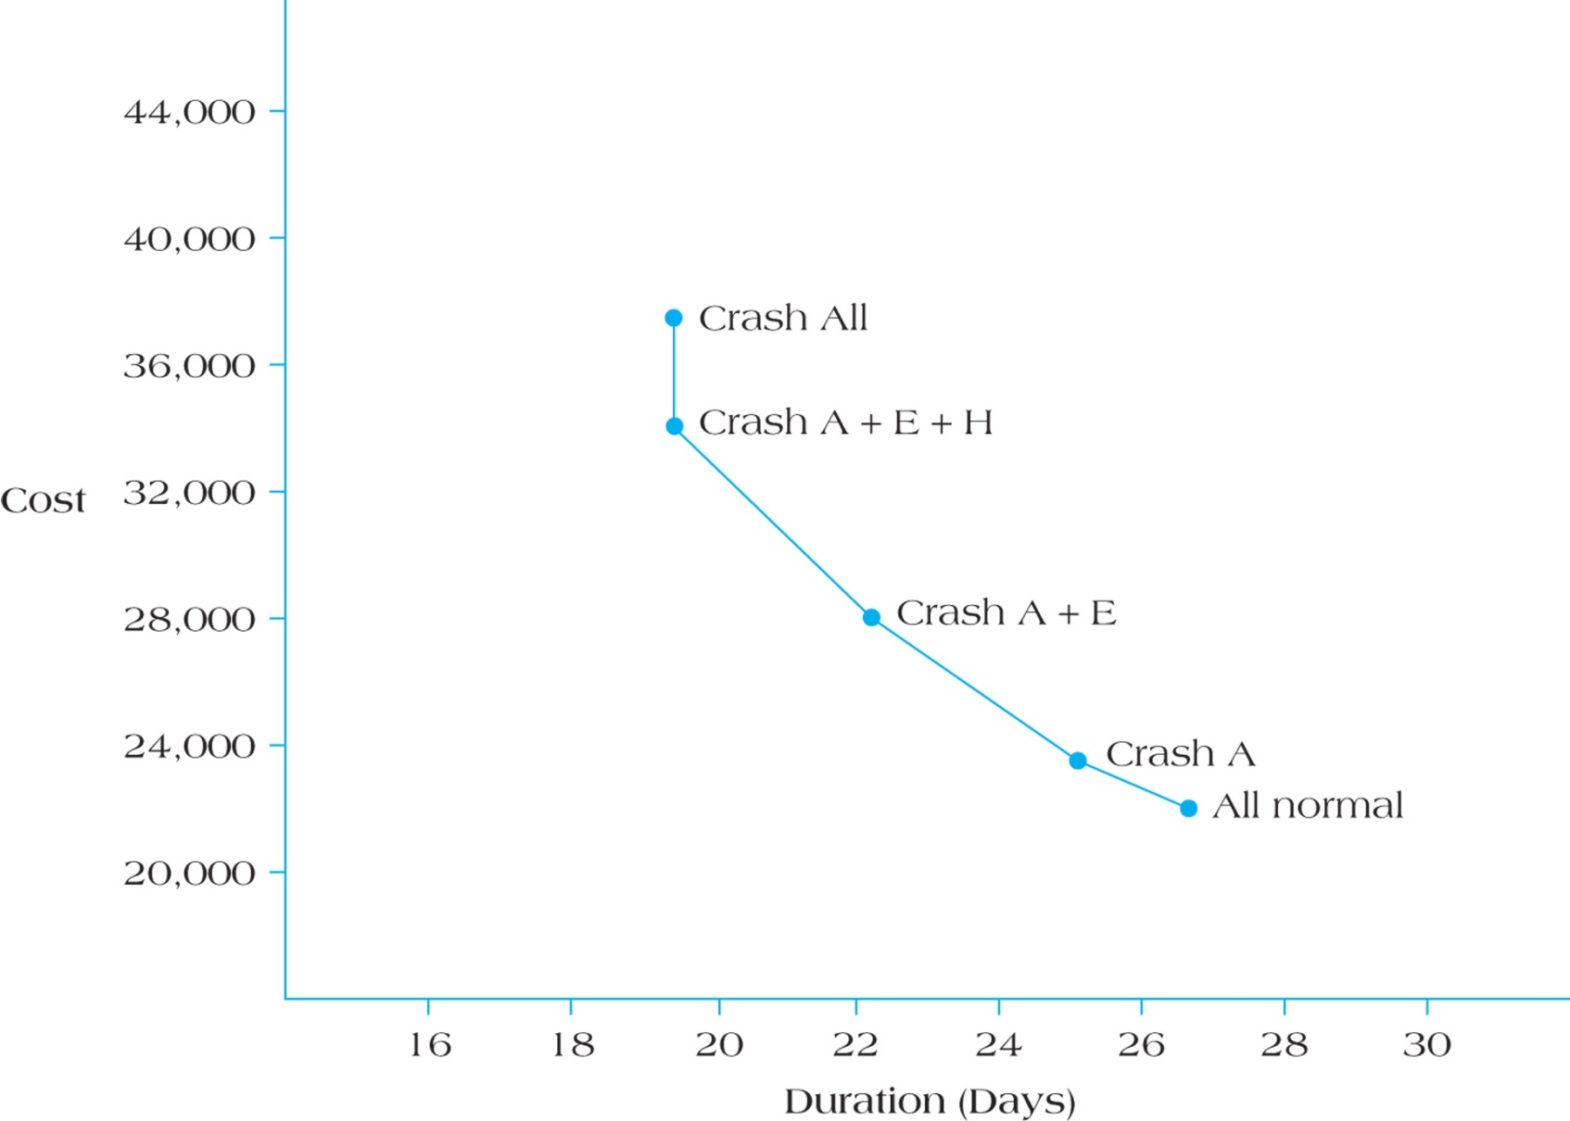
Why doesn’t “Crash All” shorten the duration more?
Crashing Steps
Starting Here
Figure 10.16 Relationship Between Cost and Days Saved in a Crashed Project
Notes:
“Crash All” means crashing all of the activities, not only the ones on the critical path. If we crash activities not on the critical path, we are not shortening our project, we are just wasting money.

Slide 32
Let’s Try a New Problem When deciding on whether or not to crash project activities, a project manager was faced with the following information. Activities on the critical path are identified with an asterisk:
 | Normal |  | Crashed |  |  | Cost/wk (just those on critical path)
Activity | Cost | Duration | Extra Cost | Duration
A | 5,000 | 4 weeks | 4,000 | 3 weeks
B* | 10,000 | 5 weeks | 3,000 | 4 weeks
C | 3,500 | 2 weeks | 2,500 | 1 week
D* | 4,500 | 6 weeks | 4,000 | 4 weeks
E* | 1,500 | 3 weeks | 2,500 | 2 weeks
F | 7,500 | 8 weeks | 5,000 | 7 weeks
G* | 3,000 | 7 weeks | 2,500 | 6 weeks
H | 2,500 | 6 weeks | 3,000 | 5 weeks
 |  | <<< What is the total cost for the Normal duration of the project
Note, no precedence table provided, we are using “*” to indicate Activities on the critical path
Is “Extra Cost” the same as the “Crashed Cost”?
Notes:
Crashed Cost means a different quote/estimate for the Activity than the Normal Cost. Extra or Incremental Cost means the additional cost to move from normal to crashed.

Slide 33
Identify the sequencing of the activities to be crashed in the first four steps. Which of the critical activities should be crashed first? Why?
What is the project’s critical path? After 5 iterations involving crashing project activities a week at a time, what has the critical path shrunk to?
Suppose project overhead fixed costs accrued at a fixed rate of $500 per week. Chart the decline in direct costs over the project life relative to the increase in overhead expenses.
Assume that a project penalty clause kicks in after 19 weeks. The penalty charged is $5,000 per week after 19 weeks. When the penalty charges are added, what does the total project cost curve look like? Develop a table listing the costs accruing on a per week basis.
If there were no penalty payments accruing to the project, would it make sense to crash any project activities? Show your work.
The Project Cost is on the preceding slide.
The Project Duration can be calculated from the preceding slide.
Printout
M5 Digital EXERCISE Cumulative Crashing w overhead & penalties.xlsx
Use Excel

Slide 34
Solution to #4 on pg. 210
- A .The correct sequence for crashing activities, cheapest first:
Activity D $2,000/week
Activity E or G (they both cost $2,500/week )
Activity E or G (they both cost $2,500/week )
Activity B $3,000/week
Following this order assumes that activities are crashed in order of their cost.
- B. The project’s critical path is B-D-E-G, or 21 weeks. After four iterations of crashing project activities, the critical path baseline has shrunk to 16 weeks and we can’t crash anymore.
- Steps C & D. The chart showing the decline in costs relative to the increase in overhead expenses would resemble the following:
Later we will discuss guidelines on choosing one vs the other
Duration | Activity Crashed (1 wk) | Cumulative Direct Costs | Penalties | Overhead | Total
21 wks |  | 37,500 | 10,000 | 10,500 | 58,000
20 wks | crash activity D by 1 wk | 37,500 + 2000 = 39,500 | 5,000 | 10,000 | 54,500
19 wks | crash D by another wk | 39,500 + 2000 = 41,500 | - 0 - | 9,500 | 51,000
18 wks | crash E by one week | 41,500 + 2500 = 44,000 | - 0 - | 9,000 | 53,000
17 wks | crash G by one week | 44,000 + 2,500 = 46,500 | - 0 - | 8,500 | 55,000
16 wks | crash B by one week | 46,500 + 3,000 = 49,500 | 0 | 8,000 | 57,500

Slide 35
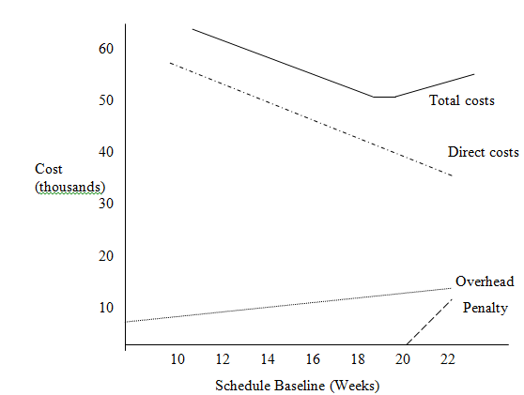
This chart is only approximately to scale
This chart is not elapsed time of a project, it represents what?
Note: if there were no penalties, there would not be a cost basis for crashing the project. It may still be appropriate given other project information such as a risk of loosing resources on the project if the project takes too long.
Notes:
The X axis on the chart shows the duration options we have available to us, but at different Total Cost price points.

Slide 36
Calculating Total Cost with Penalties
Total costs = Direct + Overhead + Penalties
Direct costs typically are the Activity costs
Overhead might include costs not in the Activities, such as rental of the office space or the PM’s cost.
Penalty is typically a late penalty charged by the customer.
Example, costs at 21 weeks
The crashed direct costs in this Project chart are similar to the costs for a crashed activity cost in a previous slide.

Slide 37
Activity on Arrow (AOA) Networks
Activities represented by arrows
Can be used in construction
Event nodes are easy to flag or track
Forward and backward pass logic similar to AON
Two activities may not begin & end at common nodes
Dummy activities may be required
We will draw an AOA diagram but first review some of the rules around drawing AOA diagrams.

Slide 38
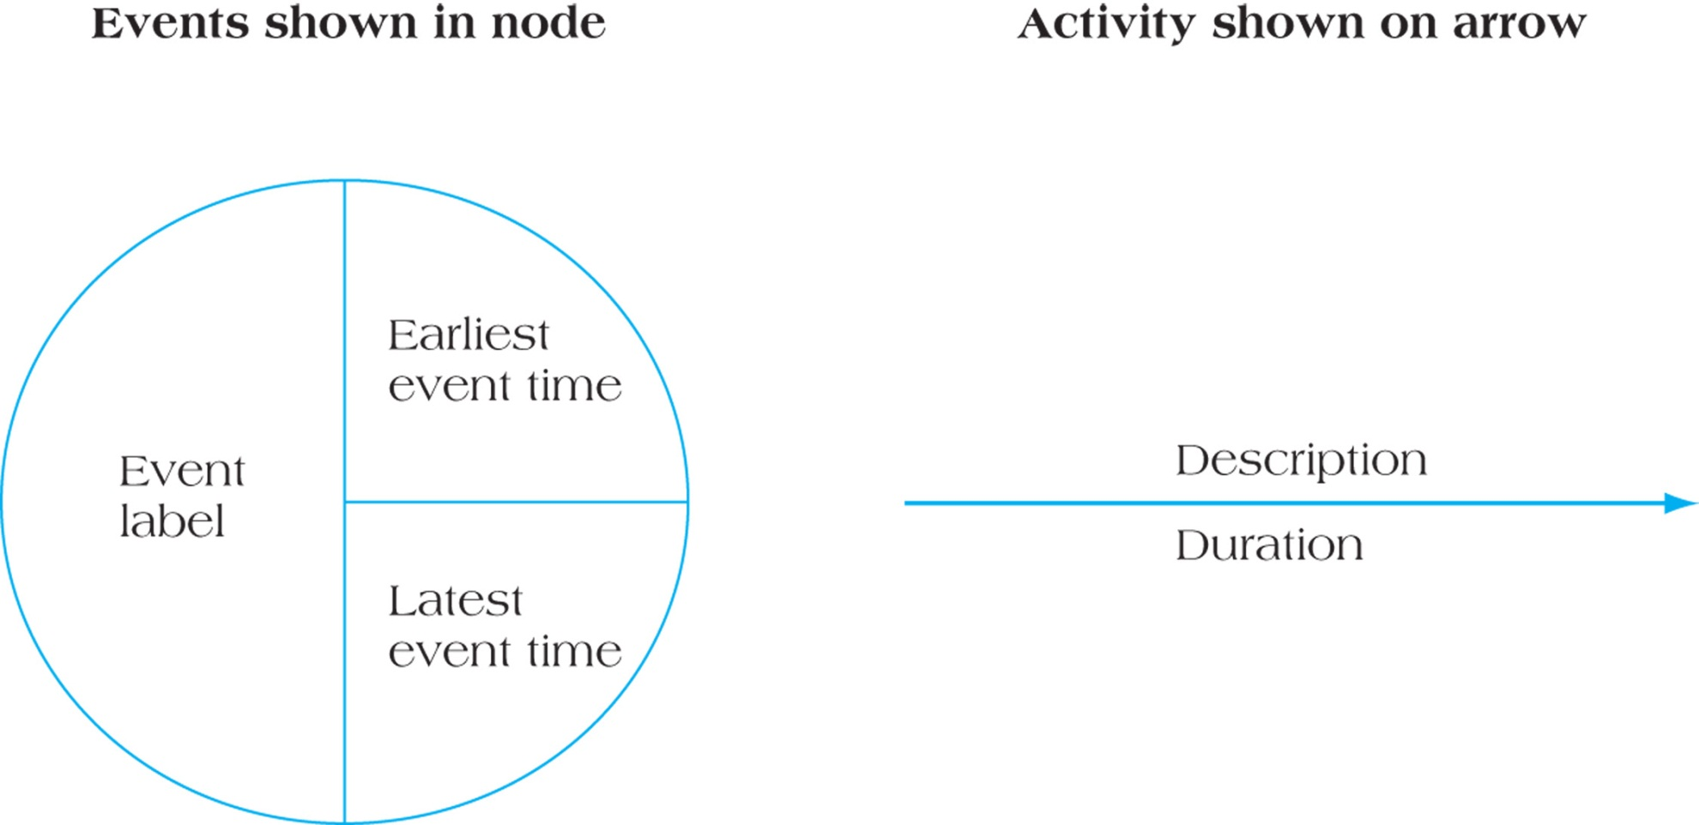
Notation for Activity-on-Arrow (AOA) Networks
Note: AOA diagrams only use Finish to Start relationships
Figure 10.18

Slide 39
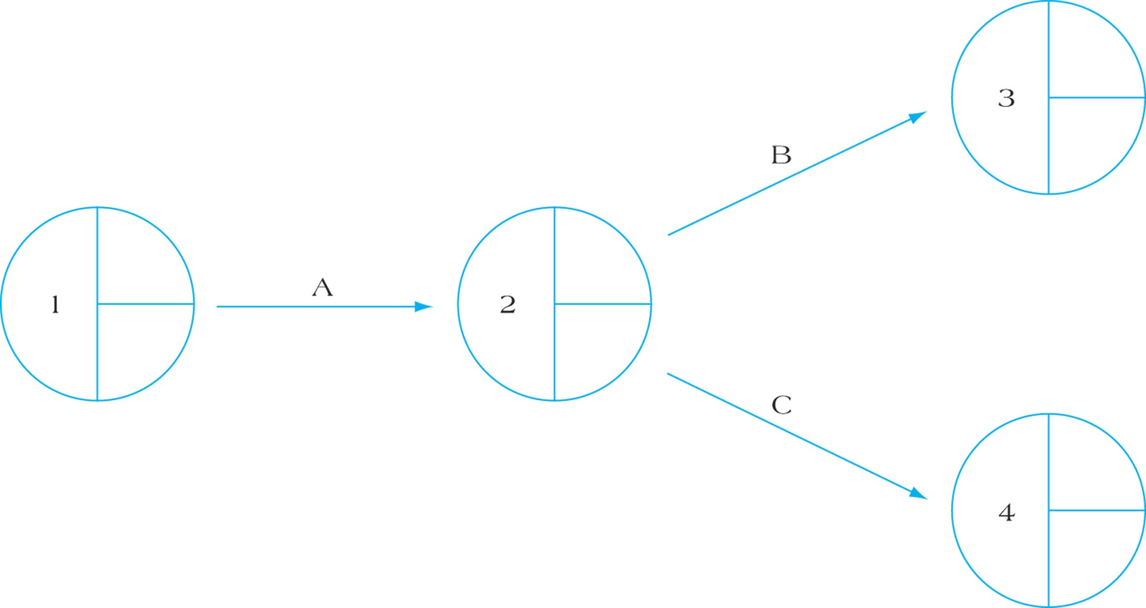
Sample Network Diagram Using AOA Approach
Both B and C are dependent on the finish of A
Figure 10.19

Slide 40
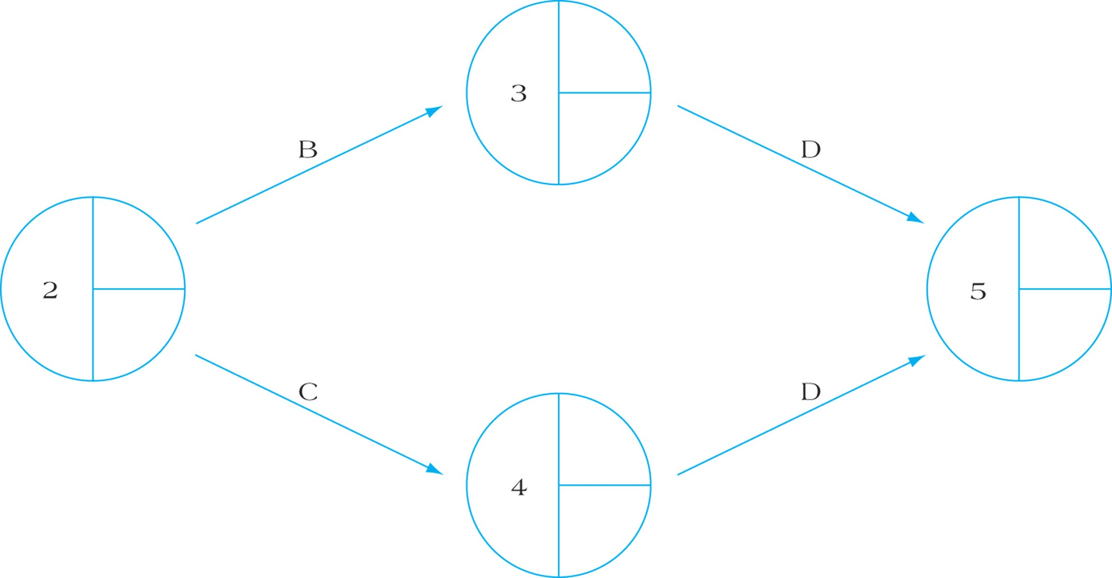
Representing Activities with Two or More Immediate Successors (Wrong)
Figure 10.20A
The intent is to show D is dependent on both B and C
But what is wrong with this diagram?
Notes:
We have D twice, and D is an Activity, so the Network diagram indicates we “do” D twice, with the corresponding costs and resources.

Slide 41
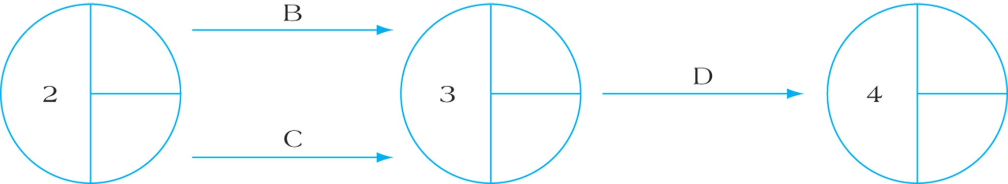
Alternative Way to Represent Activities with 2 or More Immediate Successors (Wrong approach)
Figure 10.20B
We can’t have 2 arrows (activities) starting and finishing at the same nodes

Slide 42
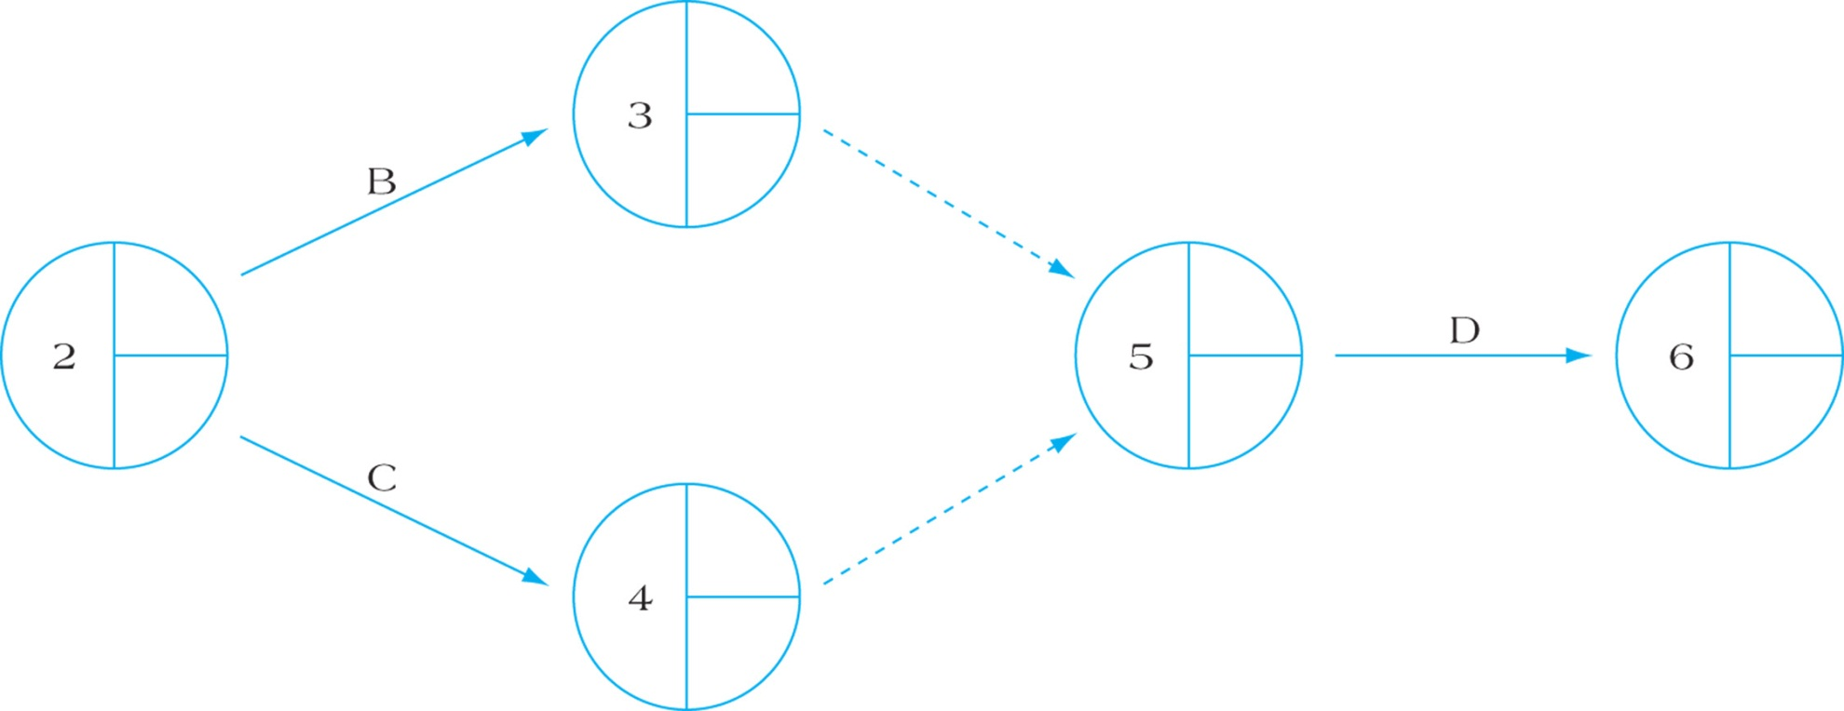
Representing Activities with 2 or More Immediate Successors - Using Dummy Activities (better, but there are other ways)
Dummy activities are used in AOA networks to indicate the existence of precedent relationships between activities and their event nodes. They are not Activities, they do not have any work or time values assigned to them. Use them sparingly.
Figure 10.20C
Notes:
D is dependent upon B and C

Slide 43
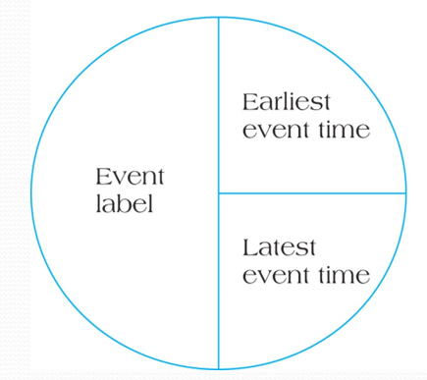
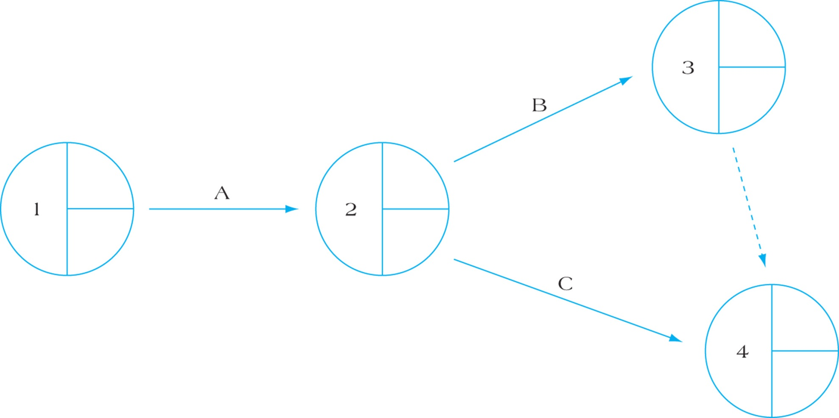
Partial Project Delta Network Using AOA Notation – Correct using only 1 dummy activity.
If Activity A was a duration of 3 days, then the Earliest Event time would be 3 days
Figure 10.21

Slide 44
Delta Project – lets Hand Draw an AOA diagram for this project (no forward pass yet)
Activity | Description | Predecessors | Estimated Duration in days
A | Contract Signing | None | 5
B | Questionnaire design | A | 5
C | Target market ID | A | 6
D | Survey sample | B, C | 13
E | Develop presentation | B | 6
F | Analyze results | D | 4
G | Demographic analysis | C | 9
H | Presentation to client | E,F,G | 2

Slide 45
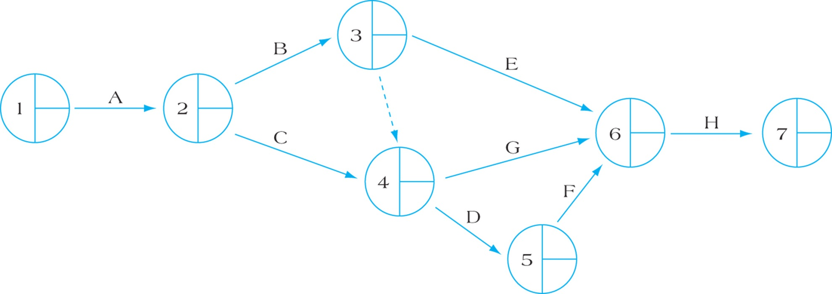
Completed Project Delta AOA Network
What is the intent of the Dummy Activity?
Is D dependent on C and B?
Is G dependent on C and B?
From our predecessor table, G is only dependent on C -- therefore a comment is required on the dummy activity to clarify this!
?
Dummy only applies to D
?
?
Figure 10.22
Let’s add our durations and do our earliest event time in a forward pass
Notes:
In our predecessor diagram, D depends on both B and C, but G depends only on C, NOT B. So the dummy arrow is meant to convey that D is dependent on B, but NOT G is dependent on B. We could add a 2nd dummy arrow that goes to a brand new event (call it event 8), and then we could have our G arrow go from this Event 8 to Event 6.

Slide 46
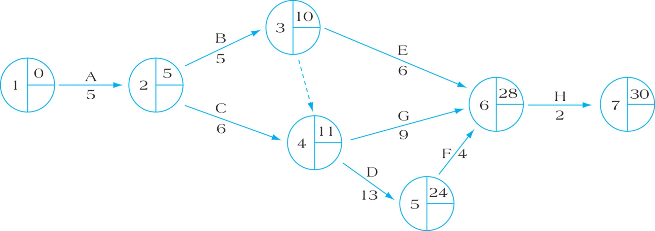
Project Delta Forward Pass Using AOA Network
Dummy only applies to D
Figure 10.23
Let’s add in our backward pass

Slide 47
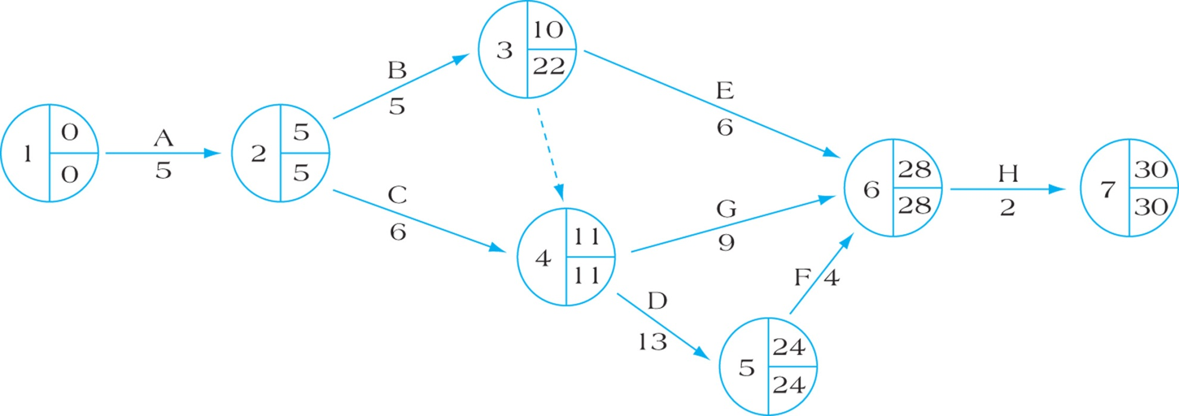
Project Delta Backward Pass Using AOA Network
What is the slack for E and G?
11
Dummy only applies to D
Figure 10.24
How can we determine slack?
It’s not as obvious as in an AON diagram
We can calculate activity slack. What is the slack for E and G? Remember G is only dependent on C.
Notes:
It’s a bit tricky working out the slack from this diagram.
Activity E slack = 12 days If we look at E and the events on either side, we can use day 10 for Early Start of E, and 28 for both the Early Finish and Late Finish. But we can NOT use 11 for the Late Start. We calculate the Late Start by taking the Late Finish of 28, and subtracting the duration of E which is 6, which gives us 22. To confirm, think of E being able to start as late as day 22 (the end of the day), and it will take 6 days to be complete, so it will finish by the end of day 28 (per Event #6). So with an Late start of 22 and Early Start of 10, our Slack is 12 days.
Activity G slack = 8 days ES =11, LS = 28 – 9 days duration = 8 days of slack.

Slide 48
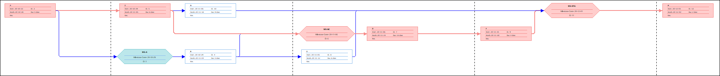
Project Delta Backward Pass Using AOA Network
11
Dummy only applies to D
Figure 10.24
A
C
G
MS
H
MS
D
F
MS
B
E
If the red circles are critical meetings/milestones where stakeholders are flying in from remote cities, it’s obvious in our simple AOA what we need to have done for the meeting. A lot of stakeholders would find this simple AOA easier to read.
It’s not as obvious in the MS Project AON diagram where we are using irregular hexagon milestones to represent the critical meetings.

Slide 49
AOA Versus AON
AON Strengths
Most computer software packages use this format
Simple network labeling easy to read and learn
AON Weaknesses
If the project is very complex with numerous paths it can be difficult to read.
AOA Strengths
Used in certain fields such as construction or where the event dates are critical
Easier to read in complex projects
AOA Weaknesses
Dummy activities (arrows) are difficult to understand
AOA diagrams can only use Finish to Start relationships

Slide 50
Controversies in the Use of Networks
Networks can get too complex
Poor network construction creates problems
Networks may be used inappropriately
When employing subcontractors
The master network must be available to them
All sub-networks must use common methods
Positive bias exists in PERT networks
What is PERT Bias? PERT assumes the project duration probability is per the critical path, but what if other paths become critical?
Notes:
What if during the execution of a project the non-critical paths get delayed, to the point where they are now longer than the critical path? These non-critical paths before the project started, were only a day shorter than the critical path, and are now 3 to 5 days longer than the critical path? Because of our PERT Bias we didn’t spend enough time looking at some of the non-critical paths.

Slide 51
Summary
Apply lag relationships to project activities.
Recognize alternative means to accelerate projects, including their benefits and drawbacks.
Understand the trade-offs required in the decision to crash project activities.
Develop activity networks using Activity-on-Arrow (AOA) techniques.
Understand the differences in AON and AOA and recognize the advantages and disadvantages of each technique.
Controversies in the - Use of Networks

Slide 52
Homework
Refer to the Start Here section of this module
Read for the next module
Kerzner 12th Ed p 414, 11th p. 663-670
PMBOK 6th Ed 6.5, 5th 6.6
Assignments, practice quizzes and graded quizzes, check the Course at a Glance and FOL/Content/Course Assignments & FOL/Evaluations/Quizzes

Slide 53


